Slide 1

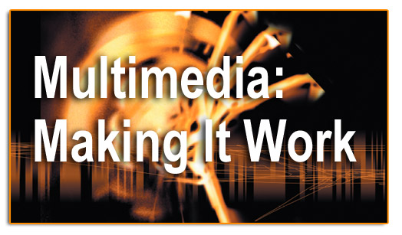
Lesson 6-Images

Slide 2
Overview
Creation of multimedia images.
Creation of still images.
Colors and palettes in multimedia.
Image file types used in multimedia.

Slide 3
Creation of Multimedia Images
Before commencing the creation of images in Multimedia, one should:
    Plan their approach using flow charts and storyboards.
    Organize the available tools.
    Have multiple monitors, if possible, for lots of screen real estate.

Slide 4
Creation of Still Images
Still images may be the most important element of a multimedia project.
The type of still images created depends on the display resolution, and hardware and software capabilities.

Slide 5
Creation of Still Images
Types of still images.
3-D drawing and rendering.

Slide 6
Types of Still Images
Still images are generated in two ways:
  Bitmaps.
  Vector-drawn graphics.

Slide 7
Bitmaps
Bitmap is derived from the words ‘bit’, which means the simplest element in which only two digits are used, and ‘map’, which is a two-dimensional matrix of these bits.
A bitmap is a data matrix describing the individual dots of an image.

Slide 8
Bitmaps
Bitmaps are an image format suited for creation of:
  Photo-realistic images.
  Complex drawings.
  Images that require fine detail.

Slide 9
Bitmaps
Bitmapped images are known as paint graphics.
A bitmap is made up of individual dots or picture elements known as pixels or pels.
Bitmapped images can have varying bit and color depths.

Slide 10
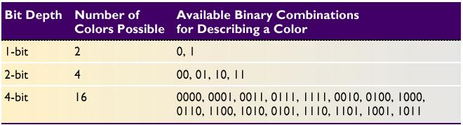
Bitmaps
Available binary Combinations for Describing a Color

Slide 11
Bitmaps
Bitmaps can be inserted by:
  Using clip art galleries.
  Using bitmap software.
  Capturing and editing images.
  Scanning images.

Slide 12
Using Clip Art Galleries
A clip art gallery is an assortment of graphics, photographs, sound, and video.
Clip arts are a popular alternative for users who do not want to create their own images.
Clip arts are available on CD-ROMs and on the Internet.

Slide 13
Using Bitmap Software
The industry standard for bitmap painting and editing programs are:
    Adobe's Photoshop and Illustrator.
    Macromedia's Fireworks.
    Corel's Painter.
    CorelDraw.
    Quark Express.

Slide 14
Capturing and Editing Images
Capturing and storing images directly from the screen is another way to assemble images for multimedia.
The PRINT SCREEN button in Windows and COMMAND-CONTROL-SHIFT-4 keystroke on the Macintosh copies the screen image to the clipboard.

Slide 15
Capturing and Editing Images
Image editing programs enable the user to:
  Enhance and make composite images.
  Alter and distort images.
  Add and delete elements.
  Morph (manipulate still images to create animated transformations).

Slide 16
Scanning Images
Users can scan images from conventional sources and make necessary alterations and manipulations.

Slide 17
Vector-Drawn Graphics
Applications of vector-drawn images.
How vector-drawn images work?
Vector-drawn images v/s bitmaps.

Slide 18
Applications of Vector-Drawn Images
Vector-drawn images are used in the following areas:
  Computer-aided design (CAD) programs.
  Graphic artists designing for the print media.
  3-D animation programs.
  Applications requiring drawing of graphic shapes.

Slide 19
How Vector-Drawn Images Work
A vector is a line that is described by the location of its two endpoints.
Vector drawing makes use of Cartesian co-ordinates.
Cartesian coordinates are numbers that describe a point in two or three-dimensional space as the intersection of X, Y, and Z axis.

Slide 20
Vector-Drawn Images v/s Bitmaps
Vector images use less memory space and have a smaller file size as compared to bitmaps.
For the Web, pages that use vector graphics in plug-ins download faster, and when used for animation, draw faster than bitmaps.

Slide 21
Vector-Drawn Images v/s Bitmaps
Vector images cannot be used for photorealistic images.
Vector images require a plug-in for Web-based display.
Bitmaps are not easily scalable and resizable.
Bitmaps can be converted to vector images using autotracing.

Slide 22
3-D Drawing and Rendering
3-D animation tools.
Features of a 3-D application.
Panoramas.

Slide 23
3-D Animation Tools
3-D animation, drawing, and rendering tools include:
  Ray Dream Designer.
  Caligari True Space 2.
  Specular Infini-D.
  Form*Z.
  NewTek's Lightwave.

Slide 24
Features of a 3-D Application
Modeling - Placing all the elements into 3-D space.
Extrusion - The shape of a plane surface extends some distance.
Lathing - A profile of the shape is rotated around a defined axis.
Rendering - Use of intricate algorithms to apply user-specified effects.

Slide 25
Panoramas
Panoramic images are created by stitching together a sequence of photos around a circle and adjusting them into a single seamless bitmap.
Software such as ULead Cool 360, and Panorama Factory are required in order to create panoramas.

Slide 26
Colors and Palettes in Multimedia
Understanding natural light and color.
Color palettes.

Slide 27
Understanding Natural Light and Color
Light comes from an atom where an electron passes from a higher to a lower energy level.
Each atom produces uniquely specific colors.
Color is the frequency of a light wave within the narrow band of the electromagnetic spectrum, to which the human eye responds.

Slide 28
Understanding Natural Light and Color
Additive color.
Subtractive color.
Monitor-specific color.
Color models.

Slide 29
Additive Color
In the additive color method, a color is created by combining colored light sources in three primary colors - red, green, and blue (RGB).
TV and computer monitors use this method.

Slide 30
Subtractive Color
In the subtractive color method, color is created by combining colored media such as paints or ink.
The colored media absorb (or subtract) some parts of the color spectrum of light and reflect the others back to the eye.

Slide 31
Subtractive Color
Subtractive color is the process used to create color in printing.
The printed page consists of tiny halftone dots of three primary colors- cyan, magenta, and yellow (CMY).

Slide 32
Monitor-Specific Colors
Colors should be used according to the target audience's monitor specifications.
The preferred monitor resolution is 800x600 pixels.
The preferred color depth is 32 bits.

Slide 33
Color Models
Models used to specify color in computer terms are:
  RGB model - A 24-bit methodology where color is specified in terms of red, green, and blue values ranging from 0 to 255.
  HSB and HSL models – Color is specified as an angle from 0 to 360 degrees on a color wheel.
  Other models include CMYK, CIE, YIQ, YUV, and YCC.

Slide 34
Color Palettes
Palettes are mathematical tables that define the color of pixels displayed on the screen.
Palettes are called ‘color lookup tables’ or CLUTs on Macintosh.
The most common palettes are 1, 4, 8, 16, and 24-bit deep.

Slide 35
Color Palettes
Dithering:
  Dithering is a process whereby the color value of each pixel is changed to the closest matching color value in the target palette.
  This is done using a mathematical algorithm.

Slide 36
Image File Types used in Multimedia
Macintosh formats.
Windows formats.
Cross-platform formats.

Slide 37
Macintosh Formats
On the Macintosh, the most commonly used format is PICT.
PICT is a complicated and versatile format developed by Apple.
Almost every image application on the Macintosh can import or export PICT files.
In a PICT file, both vector-drawn objects and bitmaps can reside side-by-side.

Slide 38
Windows Formats
The most commonly used image file format on Windows is DIB.
DIB stands for Device-independent bitmaps.
The preferred file type for multimedia developers in Windows is Resource Interchange File Format (RIFF).

Slide 39
Windows Formats
Bitmap formats used most often by Windows developers are:
  BMP - A Windows bitmap file.
  TIFF - Extensively used in DTP packages.
  PCX - Used by MS-DOS paint software.

Slide 40
Cross-Platform Formats
The image file formats that are compatible across platforms are:
    DXF - Used by CAD applications.
    Initial Graphics Exchange Standard (IGS or IGES) - Standard for transferring CAD drawings.
    JPEG and GIF - Most commonly used formats on the Web.

Slide 41
Summary
The computer generates still images as bitmaps and vector-drawn images.
Images can be incorporated in multimedia using clip arts, bitmap software, or by capturing, editing, or scanning images.
Creating 3-D images involves modeling, extruding, lathing, shading, and rendering.
Color is one of the most vital components of multimedia.

